Slide 1
SAMBHASHANAM
ChatBot with Voice
Designed by:
Devashrit Sarangi and Boudhayan Nayak
Class XI-F

Slide 2
Table of Contents
What is it?
How it works?
Benefits
Limitations
Details about Sambhashanam
What goes around behind-the-scenes to make this work
What are the benefits of such a software
What are the current limitations

Slide 3
Chatbots are computer programs designed to provide a realistic conversational experience for humans.

Slide 4
What is it?
01
Details about Sambhashanam

Slide 5
What is it?
Sambhashanam is an AI-powered voice-enabled chatbot designed to revolutionize conversational interactions.
This utilizes the cutting-edge capabilities of GPT-3.5, OpenAI's state-of-the-art language model.
Aimed at providing seamless, natural, and intuitive conversations through voice interactions.

Slide 6
How it works
02
What goes on behind the scenes for making this work.

Slide 7
How it works
Basically, our program accepts user's input via voice, processes it and then sends it to OpenAI as a prompt.
GPT 3.5 then processes that prompt and returns the appropriate text. This text is then received by the program and then it is "spoken" out by the program using Text-To-Speech.

Slide 8
Benefits
03
What are the benefits of such a software in real life

Slide 9
Benefits
Enhanced User Experience: Natural and intuitive voice interactions provide a seamless user experience.
Efficiency and Productivity: Quick access to information and task automation streamlines workflows.
Personalized Assistance: Tailored responses based on user behavior and preferences.
…and many more!

Slide 10
Limitations
04
There are some limitations in the current generation of GPT.

Slide 11
Limitations
Lack of Human Insight: GPT-3.5 lacks the ability to provide deeper insights or analysis on a given topic
Algorithmic Bias: GPT-3.5 is known to have some biases towards gender, race as it reflects the data it was trained on,
Coherence and consistency: GPT-3.5 can sometimes lose coherence over long passages and contradict itself.

Slide 12

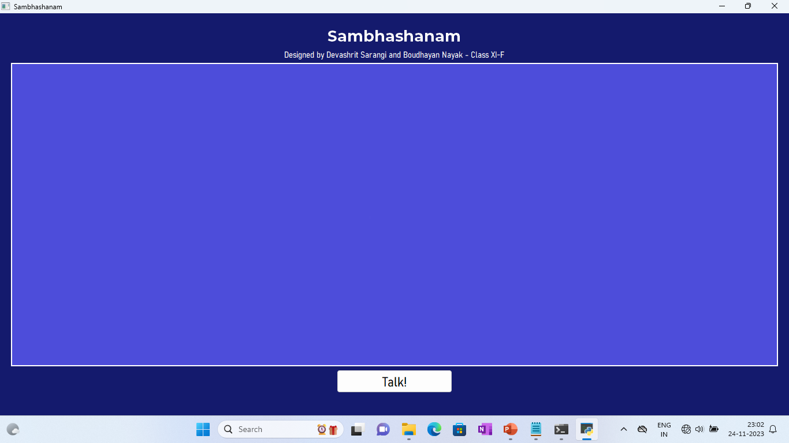
DESKTOP SOFTWARE
Screenshot of our program

Slide 13
Conclusion
Sambhashanam, powered by GPT-3.5, signifies the future of conversational AI, offering a transformative experience through voice interactions.
The innovative integration of advanced AI technology enables personalized, efficient, and scalable conversational solutions across diverse applications.

Slide 14

THANK YOU!

